Slide 1

ELECTRONIC SKILL DEVELOPMENT
PROJECT BASED LEARNING

Slide 2
PRESENTED BY
22108_HARSH UMESH BHAT
22112_SHREYAS SHREEPAD CHANDOLKAR
22118_SUNNY ARUN DHOKANE

Slide 3
Aim and Objectives
Constructing a sound-triggered switch using LM393 module and Arduino Uno.

Slide 4
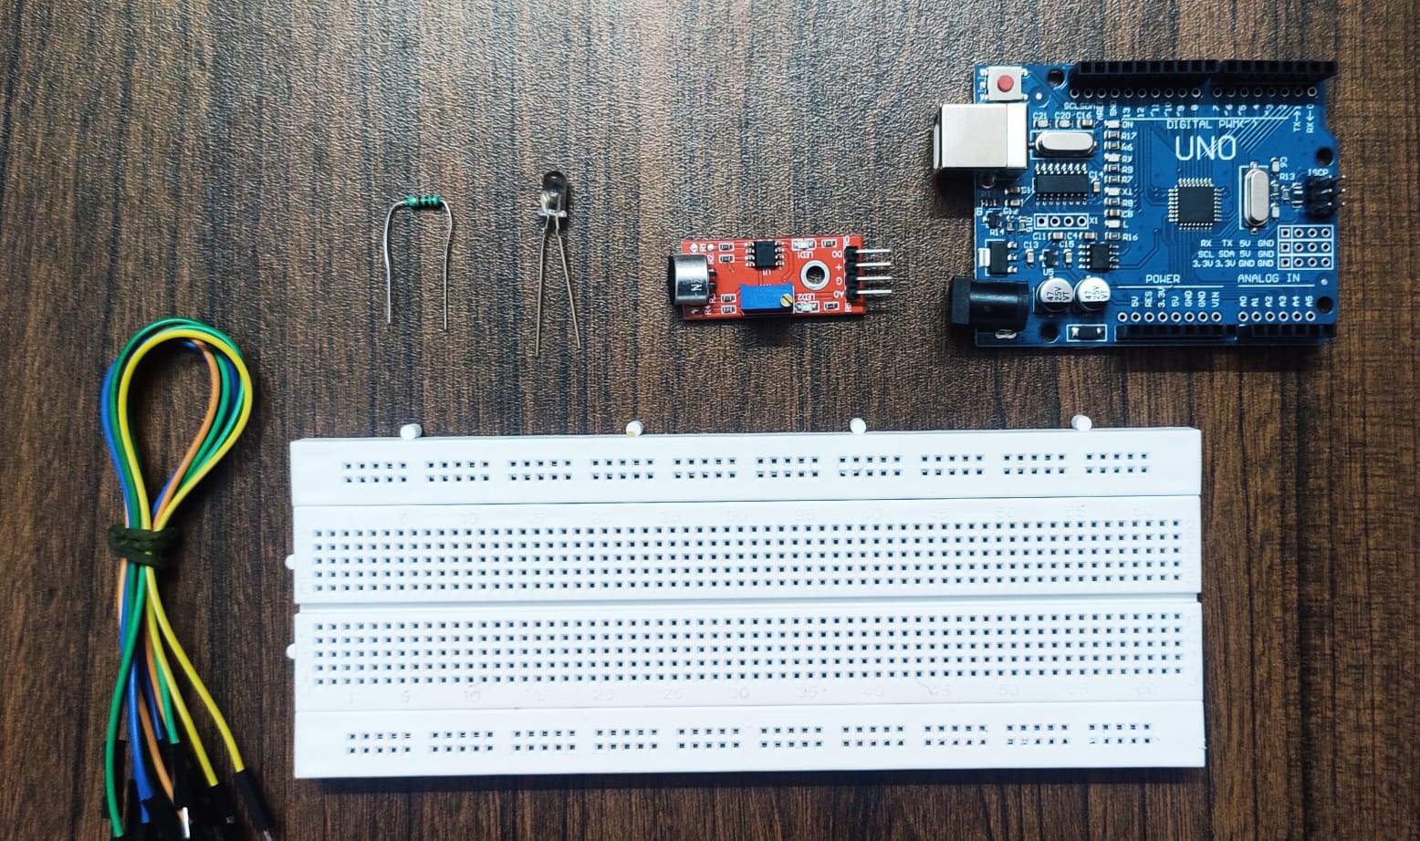
MATERIAL REQUIRED
LM393 SOUND SENSOR
ARDUINO UNO MICROCONTROLLER
BREADBOARD
RELAY MODULE

Slide 5
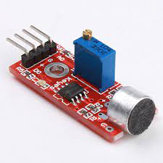
LM393 SOUND SENSOR
Sensor details –
LM393 Comparator IC is used as a voltage comparator in this Sound Detection Sensor Module. Pin 2 of LM393 is connected to Preset (10KΩ Pot) while pin 3 is connected to Microphone. The comparator IC will compare the threshold voltage set using the preset (pin2) and the Microphone pin (pin3).
Important characteristics of LM393 –
Operating Voltage: 3.3V to 5V DC
LM393 comparator with threshold pre-set
PCB Size: 3.4cm * 1.6cm
Induction distance: 0.5 Meter
Operating current: 4~5 mA
Microphone Sensitivity (1kHz): 52 to 48 dB

Slide 6
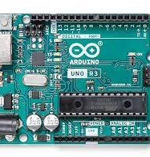
ARDUINO UNO MICROCONTROLLER
Details of Arduino UNO microcontroller –
Arduino Uno is a microcontroller board based on the ATmega328P (datasheet). It has 14 digital input/output pins (of which 6 can be used as PWM outputs), 6 analog inputs, a 16 MHz quartz crystal, a USB connection, a power jack, an ICSP header, and a reset button. It contains everything needed to support the microcontroller; simply connect it to a computer with a USB cable or power it with an AC-to-DC adapter or battery to get started.
Important characteristics of Arduino uno –
Microcontroller: ATmega328P
Operating Voltage: 5V
Input Voltage (recommended): 7-12V
In-out Voltage (limit): 6-20V
Digital I/O Pins: 14 (of which 6 provide PWM output)
PWM Digital I/O Pins: 6
Analog Input Pins: 6
DC Current per I/O Pin: 20 mA
DC current for 3.3V Pin: 50 mA
Flash Memory: 32 KB (ATmega328P) of which 0.5 KB used by bootloader
SRAM: 2 KB (ATmega328P)
EEPROM: 1 KB (ATmega328P
Clock Speed: 16 MHz
LED_BUILTIN: 13
Length: 68.6 mm
Width: 58.4 mm
Weight: 25 g

Slide 7
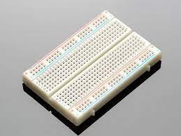
BREADBOARD
Breadboard details –
A breadboard is a rectangular plastic board with a bunch of tiny holes in it. These holes let you easily insert electronic components to prototype (meaning to build and test an early version of) an electronic circuit, like this one with a battery, switch, resistor, and an LED (light-emitting diode).

Slide 8
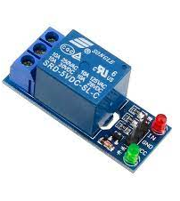
RELAY MODULE
Details of Relay Module –
Relay is an electromechanical device that uses an electric current to open or close the contacts of a switch. The single-channel relay module is much more than just a plain relay, it comprises of components that make switching and connection easier and act as indicators to show if the module is powered and if the relay is active or not.
Important characteristics of relay module –
Supply voltage – 3.75V to 6V
Quiescent current: 2mA
Current when the relay is active: ~70mA
Relay maximum contact voltage – 250VAC or 30VDC
Relay maximum current – 10A

Slide 9
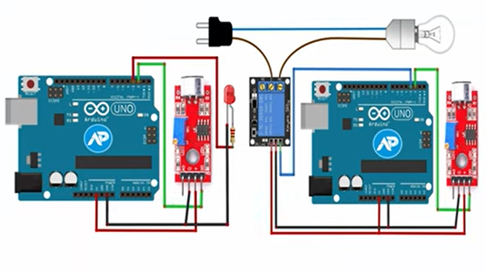
System Design

Slide 10

Implementation
Connect the LM393 module to the breadboard with VCC to positive and Ground Pin to negative.
Connect LED to the breadboard with the small terminal with the negative and big terminal with a 220-ohm resistor.
Connect Arduino Uno with its 5 V pin to the positive terminal of the breadboard and ground pin to the negative terminal. Connect 3 of Arduino Uno with 220-ohm resistor and d0 pin of the sound sensor is connected to 2 of Arduino Uno.
Connect Arduino Uno with the computer using a USB cable.
Write the required code for the functioning of this system on Arduino IDE and export.
Adjust the threshold voltage by rotating the potentiometer.
Set the threshold voltage with respect to the required loudness of sound to trigger the switch.

Slide 11
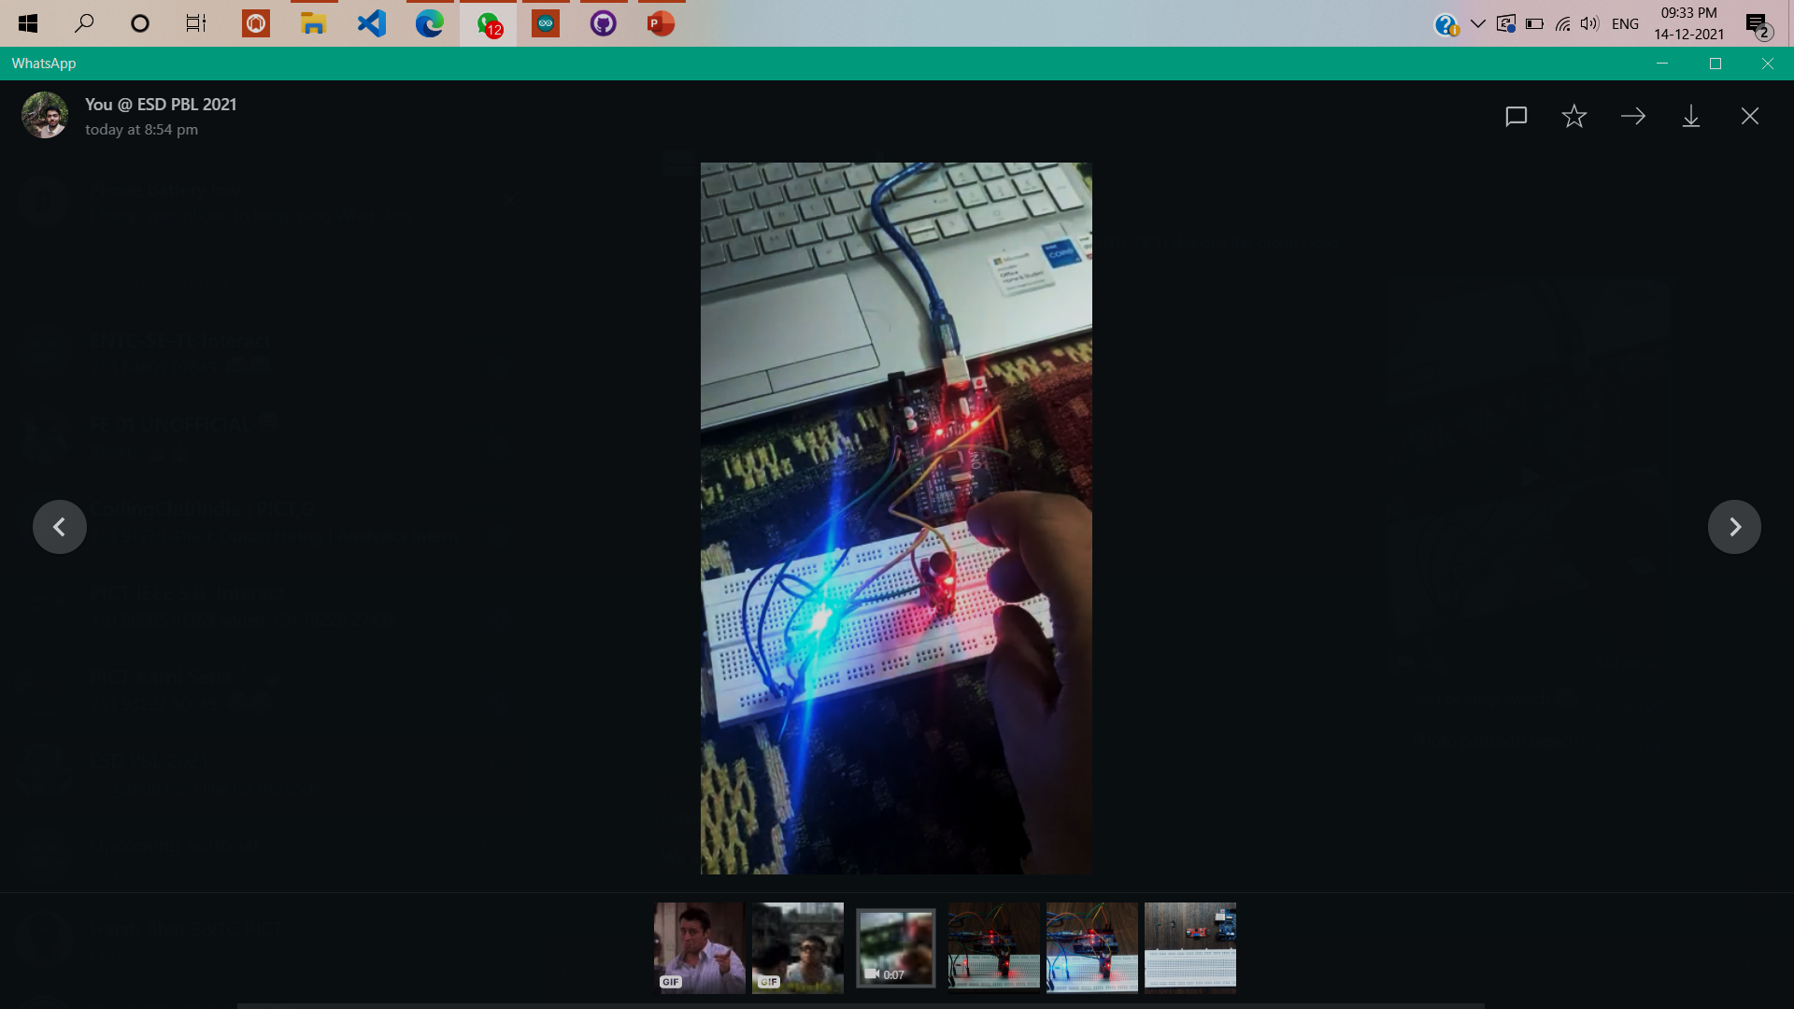
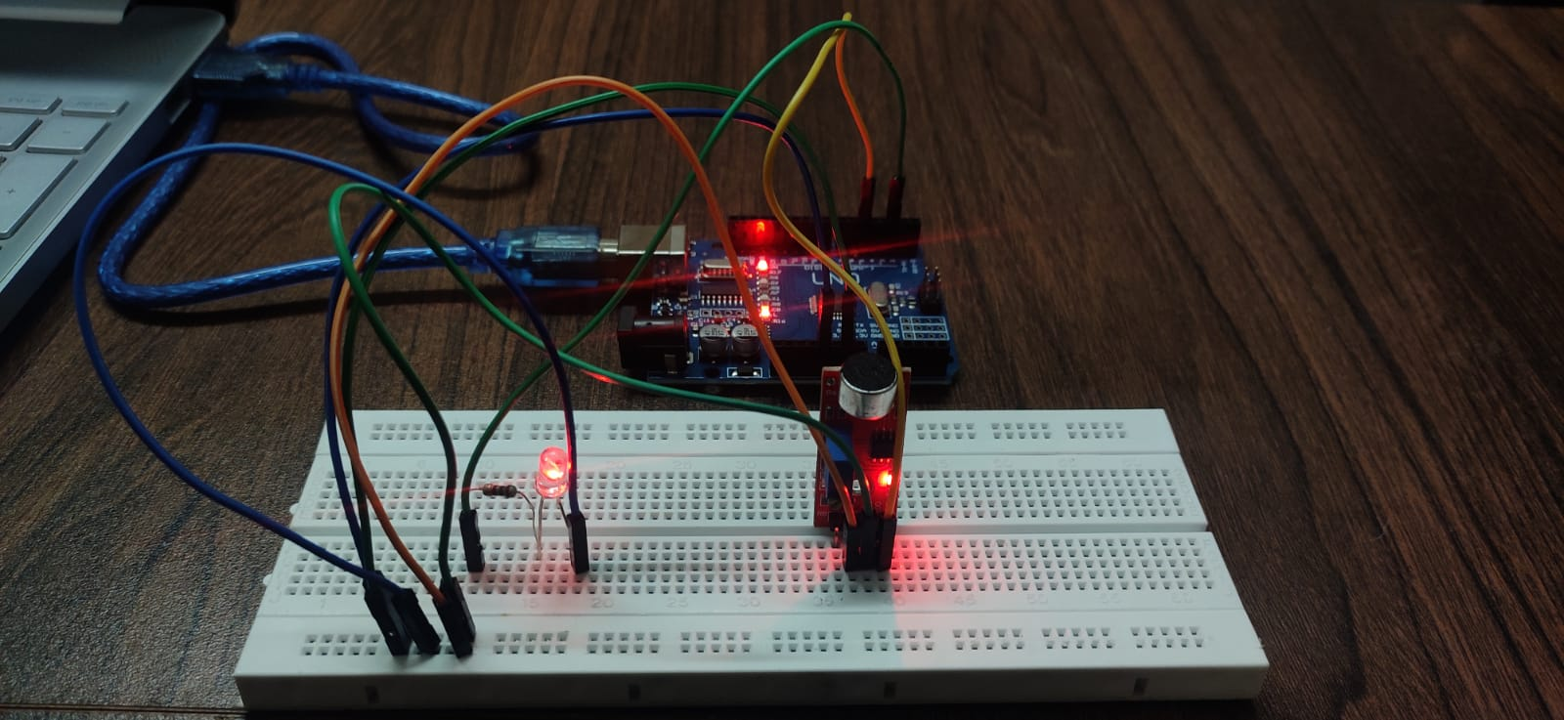
SNAPSHOTS
Arduino code GitHub repository link
https://github.com/Chandolkar001/Clap-Snap-Switch-

Slide 12

Learning Outcomes
Learned properties and applications of electronic devices such as Arduino Uno, LM393 Sound sensor, and relay module.
Learned how to use Arduino IDE and Tinker cad to design and improve the functionality of the system
Learned real-life challenges and remedies while using hardware to implement the project.

Slide 13
Conclusion
A sound-triggered switch can be constructed with ease and pace using LM393 and Arduino Uno microcontroller and can be used effectively to glow an LED using a relay module.

Slide 14


